Slide 1
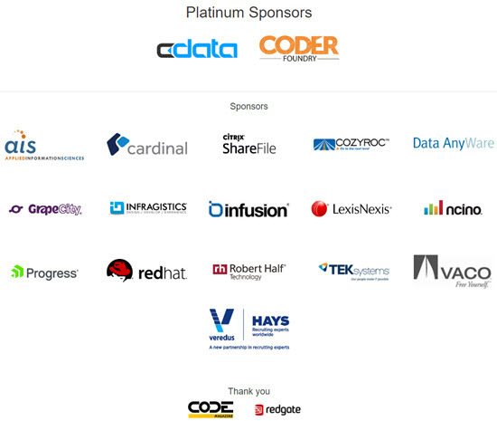
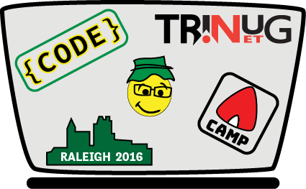

Slide 2
Domain Driven Design in 60 Minutes
Diane Wilson
Fujifilm Medical Systems
Notes:
Overview
Concepts

Slide 3
Domain Driven Design
What?
Why?
How?

Slide 4
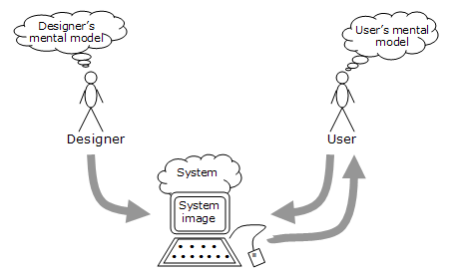
What is Domain Driven Design?
Aligning your application design with your application business model
In Domain Driven Design, there is only one model, your domain model

Slide 5
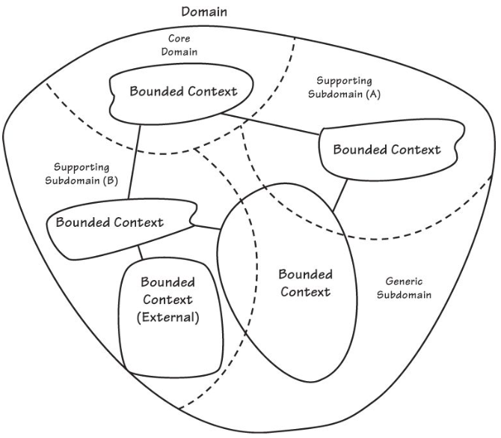

It’s about managing complexity
Simple in concept
Difficult in practice

Slide 6
What is this “Domain” you speak of?
Real-world businesses that rely on complex software…
Health care delivery
Oil markets
Air traffic control
Power grid management
Multiple disciplines
Real world impacts
Notes:
World gets more complex all the time

Slide 7
Key points
Architecture
Ubiquitous Language and Domain Model
Domains and subdomains
Bounded Contexts and Context Maps
Transition to code
Notes:
Focus on ubiquitous language and modeling

Slide 8
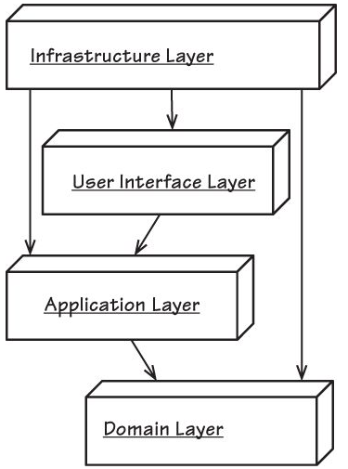
Architecture
Layered
User Interface and application(s) are outside the domain
Infrastructure is outside the domain
Communications
Messaging
Repository
Security?
Notes:
Dependency injection
Outside of everything
All based on same requirements

Slide 9
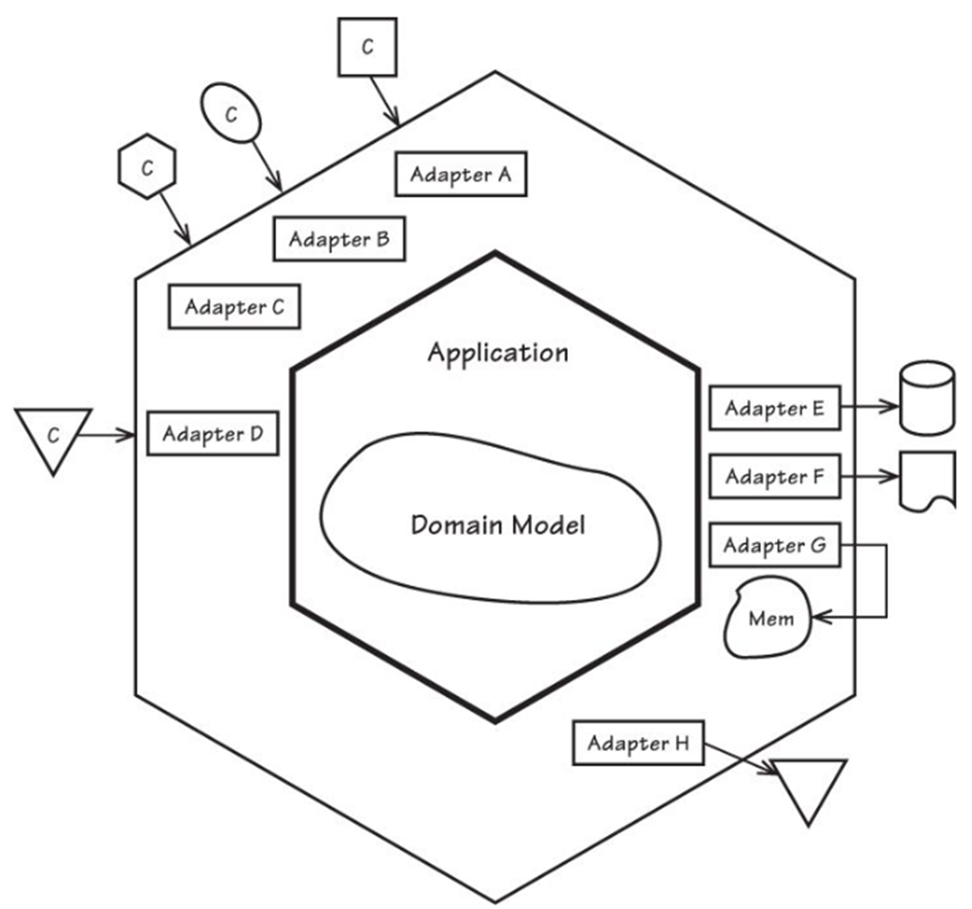
Architecture
Domain Driven Design supports many architectures
Desktop
Web
Mobile
Services
Event-driven
Event Sourcing
CQRS
Data Fabric
Distributed
Notes:
Onion
Hexagonal
Ports and Adapters
Many applications share a single domain model
You know the list…

Slide 10
Ubiquitous language
The language of the domain experts
The language shared between business, customers, and developers
The language of the domain model
The language of collaboration
Notes:
Fortunate that this is the natural language at my job
Imagine there’s no miscommunication,
It’s easy if you try

Slide 11
Ubiquitous language – an example
“Each resource within the RIS would have a field to assign a weighting factor for the dose information provided by that modality/equipment. The field would allow for calculation of a common factor for exposure to the patient regardless of manufacturer. In most cases this would be a simple multiplier, but in some cases would require more complex calculations. The intent is to provide a field for a physicist to add a consistent calculation that would be applied to all results received from a particular machine to normalize the data. Additional display values would also be optional to show per resource including adding the display value for CTDI, DLP, Organ Dose, Whole Body exposure, or other.”
Notes:
This is how we talk to each other.
Really.
Is there ambiguity here?

Slide 12
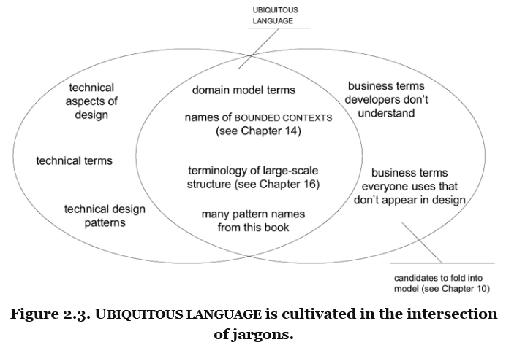
Notes:
If the domain experts don’t understand the model, the problem is in the model.

Slide 13
Value and use of models
“A model is not a document or diagram; it is the idea that the document or diagram describes.”
A ubiquitous language is a living language
A domain model is a living model
Notes:
Written documents are usually not living documents.
What is the source of “truth”? (the model)

Slide 14
Your ubiquitous language is your domain model
Names of classes and prominent operations
Rules and terms needed to discuss rules
Organizing principles imposed on the model
Patterns the team applies to the domain model
Model relationships
Describes artifacts, tasks, and functionality
Pervasively shared between developers, QA, support, domain experts, and customers
Carries large-scale aspects of design that don’t appear in code
Notes:
Starting to think about structure and code

Slide 15
From language to model to code
One model underlies implementation, design, team communications
Model, design, and implementation shape each other – iterate!
The most significant complexity is in the domain, not implementation
Code is the expression of the model
Notes:
Your culture embodies the model
Questions?

Slide 16
Domain Driven Design Patterns
Strategic Patterns
Domain
Core domain
Subdomain
Generic subdomain
Bounded context
Context map
Tactical Patterns
Value objects
(Domain) Entities
(Domain) Services
(Domain) Events
Modules
Aggregates

Slide 17
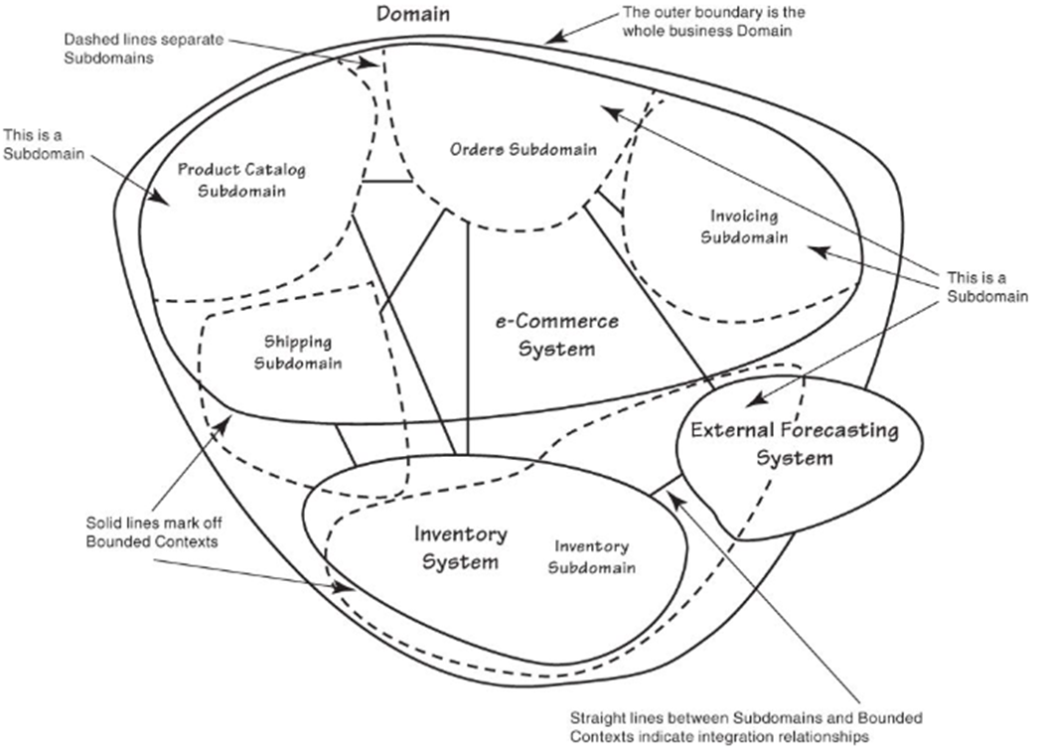

Domains and subdomains
Typical
Overlapping models and responsibilities
Unclear communications
Refined
Domain to core domain
Core domain to subdomains
Notes:
Core domain is what drives your business
Supporting subdomains are the components to run your business
Generic subdomains are “off the shelf”

Slide 18
Domains and bounded contexts
Bounded context
Related components within a subdomain
Defines the scope of the ubiquitous language
Whiteboard time
What is the name and vision for your strategic core domain?
What concepts should be part of your core domain?
List your subdomains and bounded contexts
Fit those to the abstract model
Create your own model to fit your subdomains and bounded contexts
Separate out supporting subdomains and generic subdomains
Notes:
AHA!! Requested study is not the study that a radiologist reads and reports

Slide 19
Strategic questions
What software assets exist? Can they be reused?
What needs to be created?
How do these connect and integrate?
Where are the terms of the ubiquitous languages completely different?
Where is the overlap and sharing of concepts and data between bounded contexts?
How are shared terms and overlapping concepts mapped and translated between bounded contexts?

Slide 20
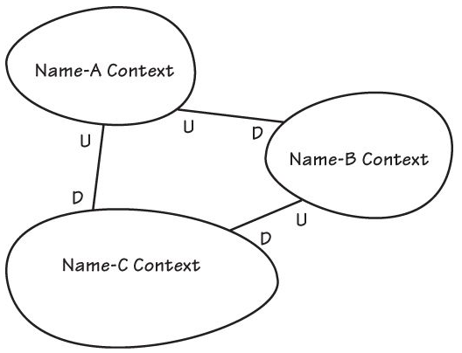
Context maps
How do Bounded Contexts Communicate?
Whiteboard time
Draw a diagram of your current project, with boundaries and relationships
NOTE: A Context Map is not an Enterprise Architecture or system topology

Slide 21
Relationships between bounded contexts
Partnership – Two contexts succeed or fail together, and cooperate
Shared Kernel – Code sharing between contexts, with interfaces tightly defined by the Ubiquitous Languages of each context
Customer-Supplier – Upstream team can succeed without the downstream context
Anticorruption Layer – Translation boundary, especially when cooperation or collaboration is not possible
Open Host Service – Open, published protocol as a set of services
Published Language – Translation between two contexts based on a published, well-documented, shared language, often combined with Open Host Service
Separate Ways – No significant relationship
Big Ball of Mud – Mixed models and inconsistent boundaries

Slide 22
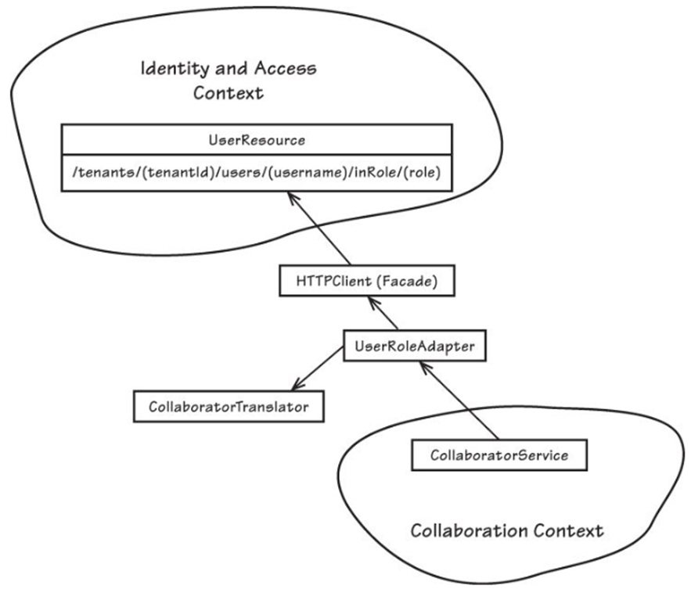
Evolved context map
Fully separated bounded contexts
Anti-corruption layer translates between contexts
Notes:
Questions before moving to code?

Slide 23
Transition to code
Visual Studio projects map to bounded context
Vocabulary scrub
A “value object” is not a .NET value type
A “domain entity” is not an Entity Framework entity
A “domain service” is not a web service
An “aggregate” is not simply object composition

Slide 24
Domain entities
Unique identity (within scope)
Mutable
Behaviors and attributes reflect ubiquitous language
Constructor provides unique identity and invariants
Reject undue influence from data model
Notes:
Invariant – entity always conforms to the rules of the model

Slide 25
Value Objects
Measure, quantify, describe
Immutable
Constructor call provides all attribute values
No public or hidden methods to change values
Not unique
Compare using value equality
Side-effect-free behaviors
Conceptually whole

Slide 26
Aggregates
Group of related domain entities and value objects
Root entity provides aggregate identity
Access to contained objects must go through aggregate
Boundary is transactional consistency
Immediate consistency within aggregate
Not open-ended
Lazy loading from persistence layer
Limited by scalability and performance
Eventual consistency may be OK outside aggregate

Slide 27
Domain services
Stateless
Domain process that is not a natural responsibility of any aggregate, entity, or value object
Fine-grained
Clearly expressed in the ubiquitous language

Slide 28
Not covered
Persistence
Domain events and event flow
Event stores and messaging
Publishing and subscription
Domain driven testing
More…

Slide 29
Domain design smells
Separate analysis and design models
Manufacturing metaphor – design, then assemble
Design model only
Technical terminology in the model
Naming problems in code
Test-driven design
No model
Notes:
Iterate, refine, refactor
Stay within ubiquitous language

Slide 30
Domain Driven Design
What?
A design paradigm based on business model
Why?
Replace complexity with clarity
How?
Use ubiquitous language and DDD patterns for modeling and implementation

Slide 31
Resources
Domain-Driven Design (Eric Evans)
Implementing Domain-Driven Design (Vaughn Vernon)
.NET Implementation of Vaughn Vernon’s Sample Project
https://github.com/VaughnVernon/IDDD_Samples_NET/
Microsoft .NET: Architecting Applications for the Enterprise (Dino Esposito)
Domain-Driven Design Quickly (Abel Avram, Floyd Marinescu)
What I’ve Learned Since the Book (Eric Evans, presentation)
Diane Wilson
https://github.com/cyloncat/TriNUG_DDD_SIGs
dianewilson@outlook.com
@dianewilsonnc

